Slide 1


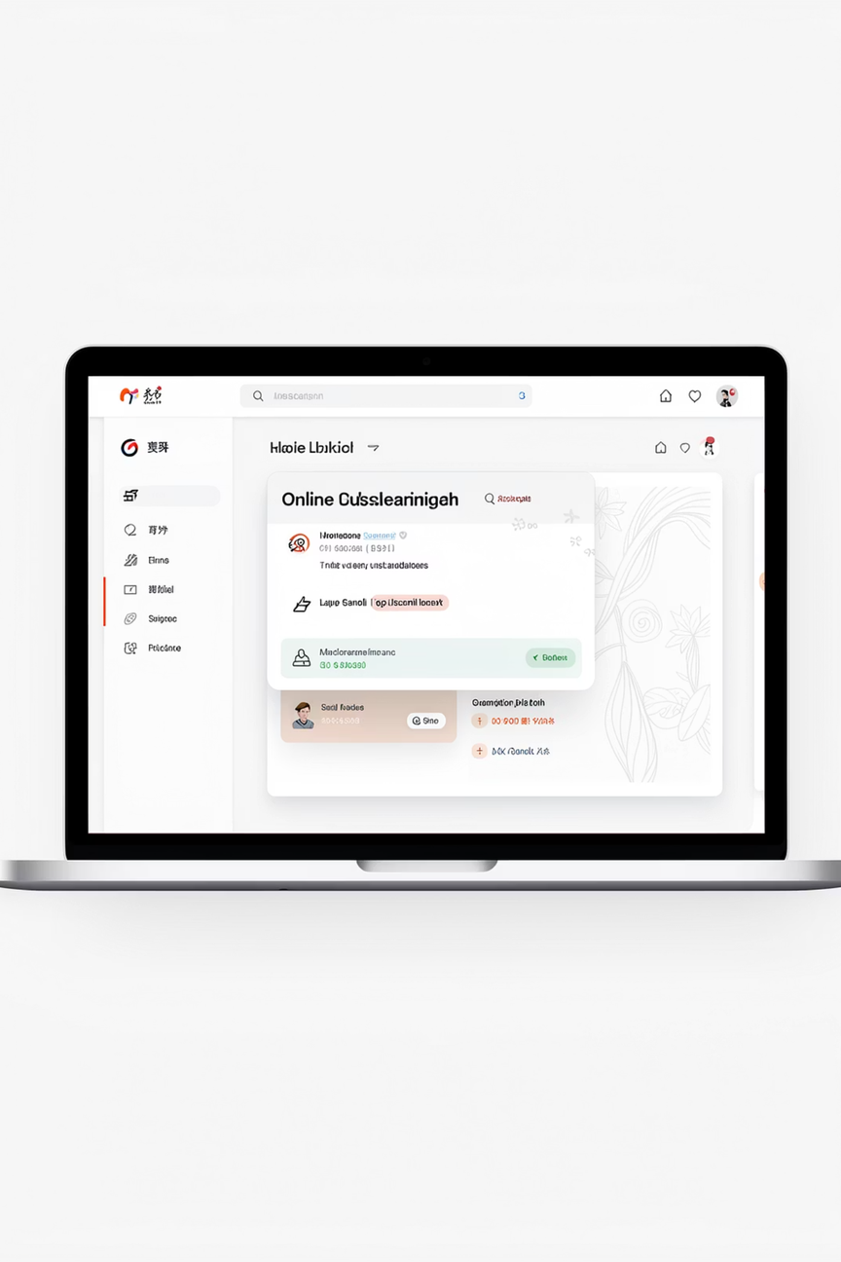
Dark Patterns in Online Learning
Ethical and Legal Issues in UI/UX Design — what happens when the interface works against the user.
16010123012 Aaryan Sharma
Notes:
1

Slide 2
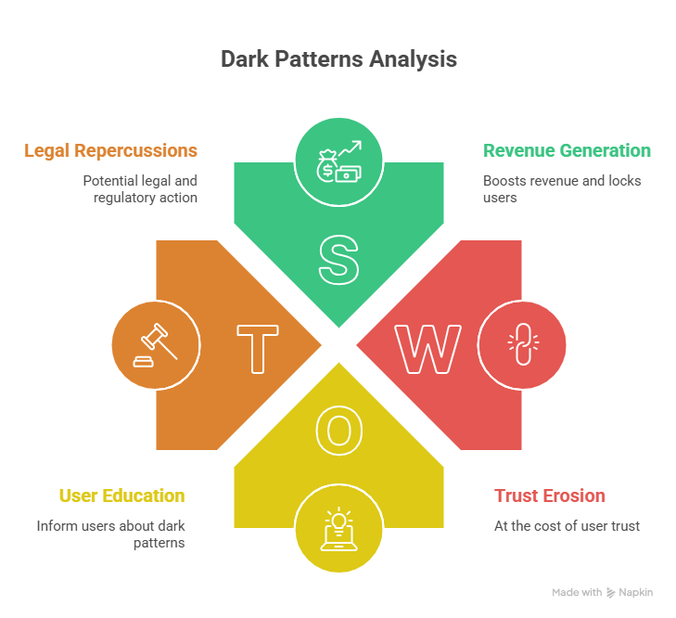
What Exactly Are Dark Patterns?
Dark patterns are design choices deliberately crafted to trick or manipulate users into doing things they didn't intend — like signing up for a subscription they can't easily cancel.
Why Companies Use Them
They boost revenue, lock in users, and reduce cancellations — at the cost of trust.
Where You'll Find Them
Online learning platforms, streaming services, e-commerce sites, and subscription apps.
Notes:
2

Slide 3
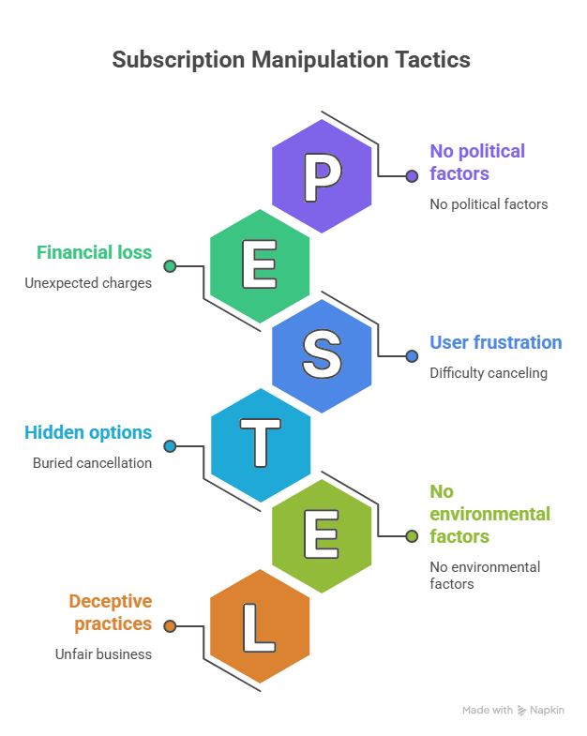

Subscription Manipulation in Action
Imagine signing up for a free trial on a learning platform. You forget about it — and suddenly you're charged. When you try to cancel, the option is buried, confusing, or requires a phone call.
This isn't an accident. It's a deliberate design strategy to make leaving harder than staying.
Notes:
3

Slide 4
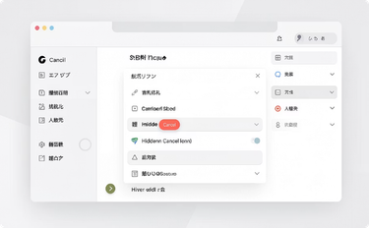
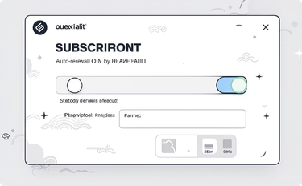
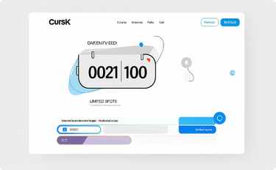
Common Dark Patterns You've Probably Seen
Hidden Cancel Option
Auto-Renewal by Default
Fake Urgency Messages
Cancellation is buried deep in settings — or requires contacting support directly.
Subscriptions renew automatically. Users must actively opt out — often without clear notice.
"Only 2 spots left!" or "Offer expires in 10 minutes" — even when it doesn't.
Notes:
4

Slide 5
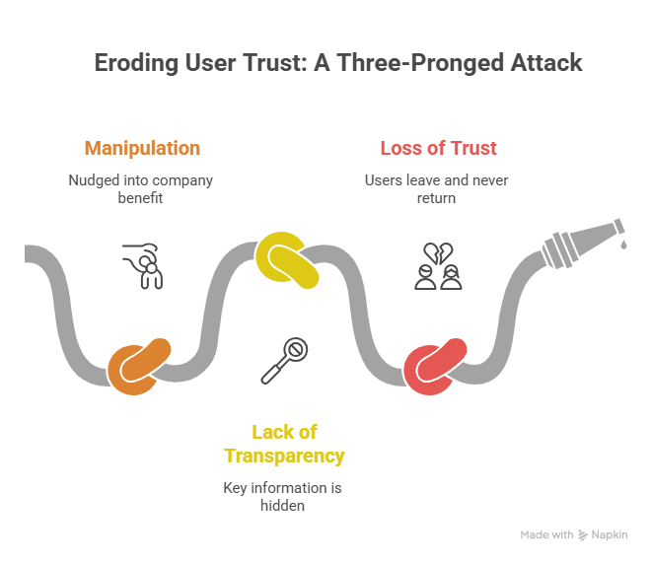
The Ethical Problems
Manipulation
Users are nudged into decisions that benefit the company, not themselves — often without realizing it.
Lack of Transparency
Key information — pricing, terms, cancellation policies — is hidden or presented confusingly.
Loss of Trust
When users feel tricked, they leave negative reviews, share bad experiences, and never return.
Notes:
5

Slide 6
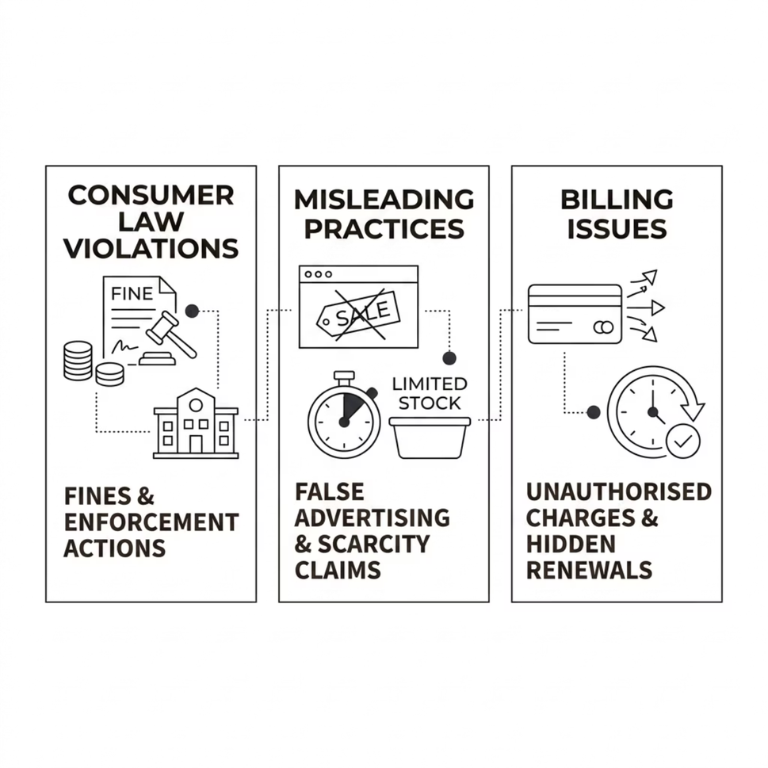

When Dark Patterns Break the Law
Regulators are cracking down. Several high-profile companies have faced fines for using deceptive UI patterns.
Consumer law violations — misleading users breaches consumer protection regulations in many countries
Billing without consent — charging users who didn't clearly agree is legally actionable
False advertising — fake urgency and inflated scarcity claims can constitute fraud
Notes:
6

Slide 7
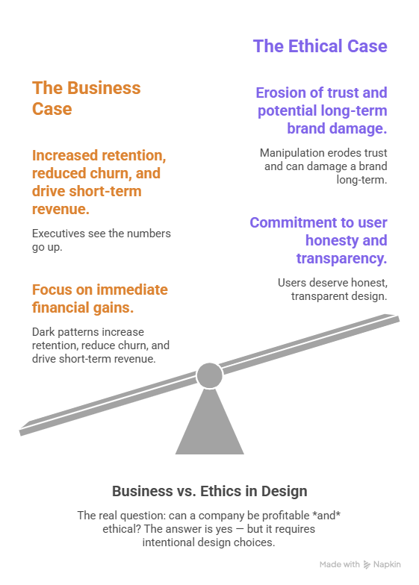

The Core Dilemma: Profit vs. Fairness
📈 The Business Case
Dark patterns increase retention, reduce churn, and drive short-term revenue. Executives see the numbers go up.
⚖️ The Ethical Case
Users deserve honest, transparent design. Manipulation erodes trust and can damage a brand long-term.
The real question: can a company be profitable and ethical? The answer is yes — but it requires intentional design choices.
Notes:
7

Slide 8
Who's Affected? The Stakeholders
Users
The Company
Students and learners who may be tricked into paying for things they don't want or can't easily cancel.
Platforms that benefit from dark patterns short-term but risk reputation and legal consequences.
Developers & Designers
Regulators
The people who build these interfaces — they have the power to choose ethical design.
Government bodies and consumer protection agencies enforcing fair practice laws.
Notes:
8

Slide 9
Two Paths Forward
❌ Dark Patterns
✅ Ethical Design
Hidden cancellation flows
Pre-checked auto-renewal
Fake countdown timers
Confusing pricing tiers
Requires phone call to cancel
One-click cancellation
Opt-in (not opt-out) renewals
Transparent, honest messaging
Clear, upfront pricing
Self-service account management
Notes:
9

Slide 10
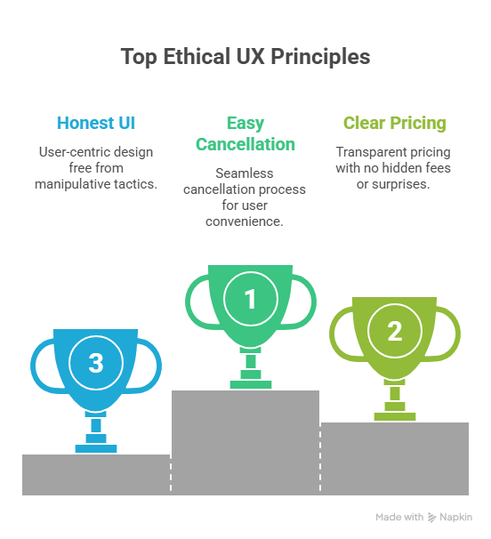
The Solution: Design With Integrity
01
02
Easy Cancellation
Clear Pricing
Let users cancel as easily as they signed up — no phone calls, no confusion.
Show the full cost upfront, including renewal terms and any auto-renewal settings.
03
Honest UI
Remove fake urgency, hidden options, and manipulative language from every screen.
Good design respects the user. When ethics and UX align, everyone wins — the user, the company, and the designer.
Notes:
10

Slide 11
Thank You

